Slide 1
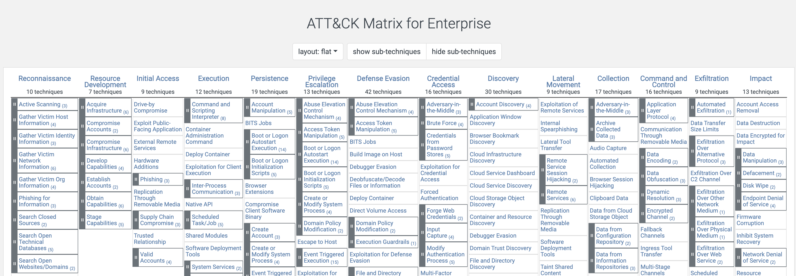
MITRE ATT&CK
https://attack.mitre.org/
Today we will be discussing Lateral Movement.

Slide 2
Lateral Movement

Slide 3
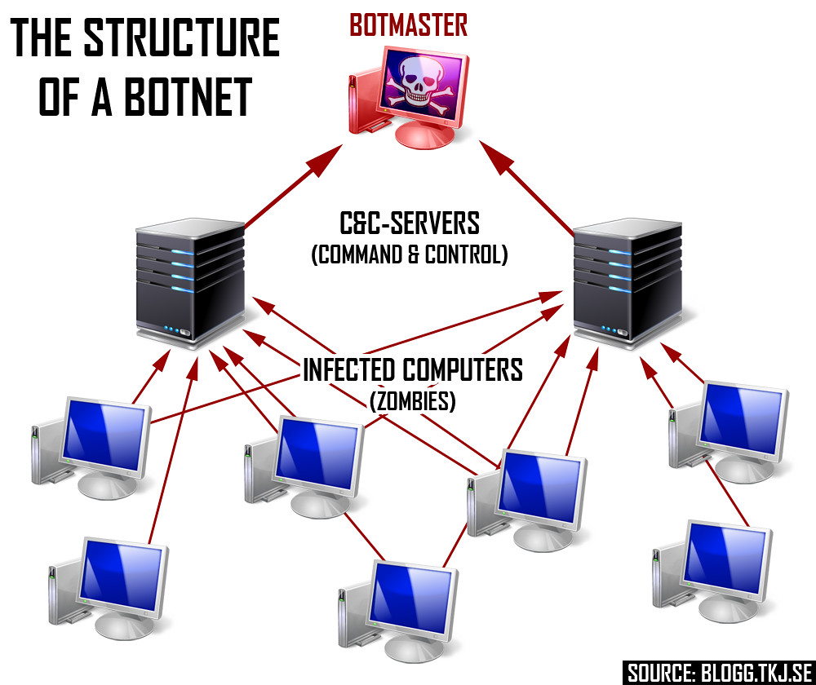
What is Lateral Movement?
As we have discussed previously, the system(s), account(s) or resource(s) an attacker lands on first / early on, in most cases does not allow them to fully accomplish their objectives.
One important thing to remember is that lateral movement involves more than just the scenario of malware moving from one host to another. While in some cases, this represents the complete picture, more often it involves credentials, services, and/or tools that give them a great deal of influence within an environment.

Slide 4

Examples of Lateral Movement Techniques
Exploitation of remote services or APIs.
Internal spear phishing or social engineering using important users/accounts.
Pass the hash/pass the ticket
Authenticate using sniffed or compromised credentials.
Circle back to execution phase, but on a new host now.
This Photo by Unknown Author is licensed under CC BY

